Slide 1
System and Network Administration
Net-R

Slide 2
Vulnerability Assessment
A vulnerability assessment is an internal audit of your network and system security
If you were to perform a vulnerability assessment of your home, you would check each door to see if they are shut and locked, and check every window, making sure that they shut completely and latch correctly.
This same concept applies to systems, networks, and electronic data. Malicious users are the thieves and vandals of your data. Focus on their tools, mentality, and motivations, and you can then react swiftly to their actions.

Slide 3
Checklist
List of Hosts
List of type and versions of OS used
List of services provided
List of patches applied & non-standard software
Test for weak passwords (crack, satan, john the ripper)*
Ensure latest security patches are applied
Evaluate trust relationships between hosts
Monitor processes: watch for unusual or excessive process spawning
Check file system for suspicious files
Use a port scanner to find vulnerabilities*
* Try it first – before someone tries it on you
Notes:
3
Trust Relationships are v.difficult to disentangle. They are an “Implied Dependency”. Complexity of trust relationships between host services is usually hidden and not immediately obvious! This especially applies to NFS mounts. Eg. The root user on a machine allowed to mount remote files systems has total access and may be able to access private user data located there.
rlogin, rsh, rexec etc.. All rely on trust relations which allow nominated users and hosts (those found in .rhosts and hosts.equiv) to login directly

Slide 4
RedHat 9 Security Guide
8. Vulnerability Assessment
8.1. Thinking Like the Enemy
8.2. Defining Assessment and Testing
8.3. Evaluating the Tools
10. Incident Response
10.1. Defining Incident Response
10.2. Creating an Incident Response Plan
10.3. Implementing the Incident Response Plan
10.4. Investigating the Incident
10.5. Restoring and Recovering Resources
10.6. Reporting the Incident
Appendix A. Common Exploits and Attacks

Slide 5
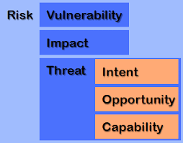
Intruder prevention
White hat hackers (penetration testing)
Scanning
Vulnerability analysis
System update/patch

Slide 6
Threat Model
A threat model helps in analyzing a security problem, design mitigation strategies, and evaluate solutions
Steps:
Identify attackers, assets, threats and other components
Rank the threats
Choose mitigation strategies
Build solutions based on the strategies

Slide 7
Intrusion Lifecycle
Phase | Technique | Description
 | Reconnaissance | Gather as much info about targets as possible. Required to craft an attack.
 | Initial exploitation | Gain access to network or hosts, obtain credentials, etc.
 | Privilege escalation | Gain greater control over systems. Can do more damage with higher privileges.
 | Pivoting | Compromise a central host. Spread to other hosts and network segments.
 | Persistence | Maintaining access is an important goal. Avoiding discovery, erasing traces of activity
1
2
3
4
5

Slide 8
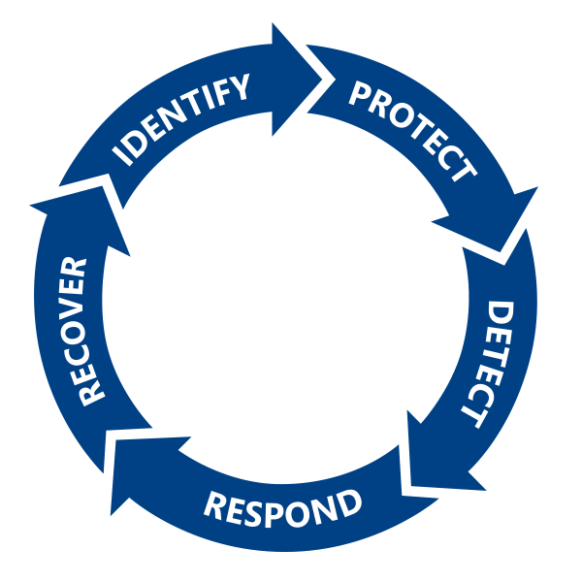
NIST Cybersecurity Framework
Identify high-value assets
Protect against known and unknown threats
Detect attacks
Respond to suspicious activity
Recover from breach
A cycle of Continuous Improvement

Slide 9
Vulnerability Assessment
A vulnerability assessment is an internal audit of your network and system security
If you were to perform a vulnerability assessment of your home, you would check each door to see if they are shut and locked, and check every window, making sure that they shut completely and latch correctly.
This same concept applies to systems, networks, and electronic data. Malicious users are the thieves and vandals of your data. Focus on their tools, mentality, and motivations, and you can then react swiftly to their actions.

Slide 10
Vulnerability Assessment Tools
Tool Type | Implement To
Vulnerability scanner | Assess systems, networks, and apps for weaknesses.
Port scanner | Assess current state of all ports on a network.
Protocol analyzer /packet sniffer | Assess traffic and what it reveals about contents and protocols being used.
Fingerprinting tools | Identify a target's OS information and running services.
Network enumerator | Map logical structure of network and identify rogue systems.
Password cracker | Recover secret passwords from stored or transmitted data.
Backup utilities | Create copies of scanned data.

Slide 11
Checklist
List of Hosts
List of type and versions of OS used
List of services provided
List of patches applied & non-standard software
Test for weak passwords (crack, satan, john the ripper)*
Ensure latest security patches are applied
Evaluate trust relationships between hosts
Monitor processes: watch for unusual or excessive process spawning
Check file system for suspicious files
Use a port scanner to find vulnerabilities*
* Try it first – before someone tries it on you
Notes:
11
Trust Relationships are v.difficult to disentangle. They are an “Implied Dependency”. Complexity of trust relationships between host services is usually hidden and not immediately obvious! This especially applies to NFS mounts. Eg. The root user on a machine allowed to mount remote files systems has total access and may be able to access private user data located there.
rlogin, rsh, rexec etc.. All rely on trust relations which allow nominated users and hosts (those found in .rhosts and hosts.equiv) to login directly

Slide 12




Slide 13
net-r
A Tinynet looks like a standard corporate network, which means it is a great attack target.
SetRole.sh has two options: one to set up hosts on a 192.168.234.0/24 subnet and one to set up a dnsmasq server for it.
The result is "rogue" subnet that automatically generates traffic, just asking to be sniffed or spoofed.
It is ideal to run alongside a VM with a linux security distro like Kali.

Slide 14
net-r
As soon as there are two hosts on this network they will start sending (silly) messages to each other.
There is a user otto automatically logged in on tty8 and all you have to do is Alt F8 to see them.
Every host that joins the network will add to this messaging frenzy, making this a very busy subnet.
Check Breaking Bad on my-tiny.net get some ideas about how to generate other kinds of traffic.
Note carefully that you need to slow down loops that use netcat: follow the examples in /var/net-r to avoid locking up the system completely.

Slide 15
net-r
Once you have your regular TinyNet fully configured, you can clone your WebServer, MailHost, and LDAPhost and add them to net-r.
Set up cnames on the net-r domserv, make sure Squirrelmail will use the submission port on the MailServer, and you're ready to try the automatic mail sending script
Mail going outside the subnet will fail, but that's OK because we want this network isolated.

Slide 16
net-r
It important to keep net-r isolated from other nets (real or virtual)
Recommended:
Only start as required
No ip forwarding between interfaces

Slide 18
Core Concepts
A process is the basic unit of activity for the operating system
A file is an object that a process can read from and/or write to
Every device in the system is represented by a file - even memory is a file.
The command line is a process known as the shell

Slide 19
stdin, stdout, stderr
File descriptors are numbers that index a per-process data structure in the kernel that records which I/O channels (file, device, socket, pipe) a process has open. Each I/O system call (read, write, etc.) takes a file descriptor that indicates which channel the call should operate on.
By convention, the first entry in the table has index 0 and is called standard input (stdin), 1 is the standard output (stdout) and 2 is the standard error (stderr) channel.

Slide 20
Pipe
Perhaps the most commonly used character is | is referred to as "pipe".
This enables you to pass the output of one command through as the input to another.
Essentially, the shell redirects the left side command's stdout to the right side command's stdin
This connection applies only to these particular processes, and lasts only as long as the processes run

Slide 21
Pipe
So, for example, if we run the command
ls -l | more
the output (stdout) of the ls command will be "piped through more". In detail, this command tells the shell to
1. create a process for ls
2. create a process for more
3. connect ls stdout (FD1) to more stdin (FD0)

Slide 22
Named Pipe
Technically, a Unix "named pipe" is a First In First Out (FIFO) interproccess communication mechanism.
In contrast to "unnamed pipes" (represented by | between two commands) a named pipe appears as a special file in the filesystem, which can be accessed by independent processes.

Slide 23
Named Pipe
Using a named pipe is straightforward, just write something to it in one process and read from it in another.
Data written to the named pipe will be stored until another process reads from the pipe.
The first process will exit when it's done writing and sends EOF, and the second process stops when it sees the EOF and exits.

Slide 24
Net-R Messaging System
/etc/inittab
/var/net-r/autologin.sh (tty8)
var/net-r/.bash_profile
Make list
Hostlist listener
Traffic listener
Show message
(DomServ)
Send loop
Send message
Copy list
Stop message
(chmod)

